Slide 1
A Study Of The Book Of Revelation
January 3, 2021

Slide 2
Resources used:
A Study Of The Book Of Revelation by Bob Dodson
More Than Conquerors by William Hendriksen
Overcoming With The Lamb, Florida College Annual Lectures, February 7-10, 1994
Revelation: An Introduction and Commentary by Homer Hailey
Revelation (Truth Commentaries) by Robert Harkrider
Revelation (A Study Workbook) by Robert Harkrider
Revelation by Donnie Rader
Revelation charts by Keith Greer.
Studies In The Book Of Revelation by Ferrell Jenkins
The Old Testament In The Book Of Revelation by Ferrell Jenkins
The Revelation Of Saint John The Divine by G.B. Caird
The Book of Revelation by Foy E. Wallace
The Avenging of the Apostles and Prophets by Arthur M. Ogden
Worthy Is The Lamb by Ray Summers
Written exchange on “The Domitian Persecution” between Arthur M. Ogden and Ferrell Jenkins presented in Searching The Scriptures, June 12, 1989, pages 7-12

Slide 3
Revelation
I. Struggle on Earth (1-11)
A. John’s Vision (1)
B. Letters to seven churches (2-3)
C. God in control (4-5)
D. Opening of seven seals (6-11)

Slide 4
Revelation
II. Christ And The Dragon In Conflict (12-22)
(Deeper Spiritual Meaning)
A. War – The Woman, the Dragon, and the Man-Child (12-14)
B. Bowls of Wrath (15-16)
C. Fall of Babylon the Harlot (17-18)
D. Victory of God’s people (19-21)
E. Warnings about the Book (22)

Slide 5
Revelation 12
Causes / Drives
1-11
Describes:
Things on
Earth
Struggle
12-22
Describes:
Forces at Work
in Spiritual
Realm

Slide 6
Revelation 12
1-11
Victory
from the
vantage point
of the
Christian / Earth
12-22
Victory
from the
vantage point
of
God / Heaven

Slide 7
Revelation 12
“The Woman and The Dragon At War”
Outline
I. The Woman, the Dragon, and the Male Child (verses 1-6)
II. War In Heaven (verses 7-12)
III. Persecution of the Woman (verses 13-17)

Slide 8
“The Woman and The Dragon At War”
Key Verse
Revelation 12:17
“And the dragon waxed wroth (enraged NASV) with the woman, and went away to make war with the rest of her seed, that keep the commandments of God, and hold the testimony of Jesus”

Slide 9
Revelation 12
What Is The Point?
It’s all a battle with Satan
Fought Against Christ
Birth
Death
Then his people

Slide 10
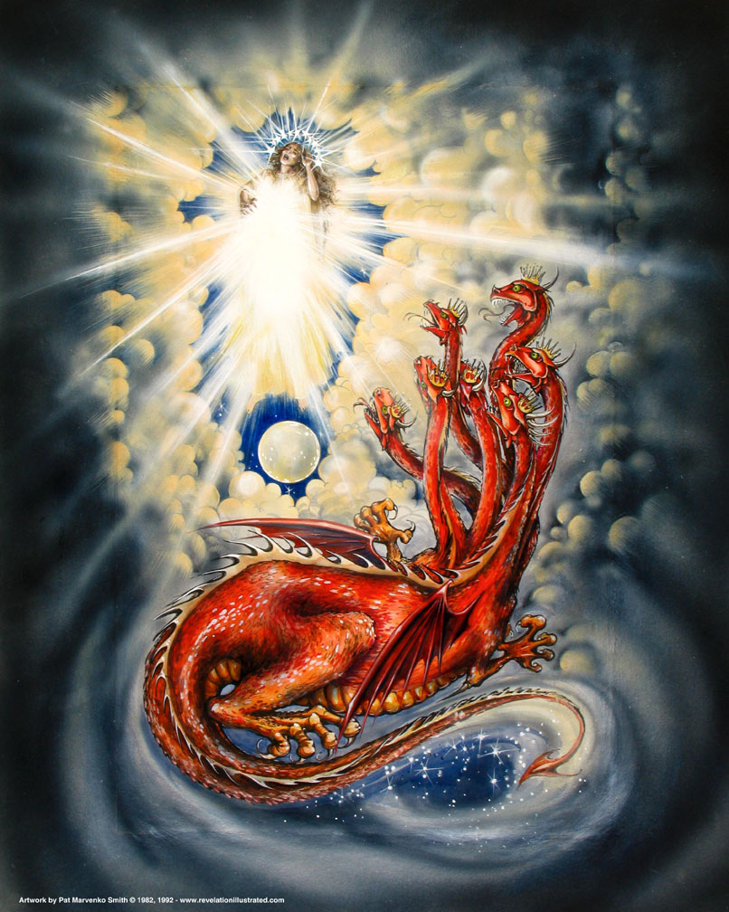
Book of Revelation: Chapter 12
Revelation 12
Basis of the Conflict – The Woman, The Dragon, and The Child

Slide 11
Deeper Spiritual Background
Revelation 12
Basic outline of Revelation:
The church’s conflict in and with the world
Chapters 1 – 11
The inner struggle between Christ and Satan
Chapters 12 – 22

Slide 12
Deeper Spiritual Background
Revelation 12
Chapter 12 begins Part 2 of the Apocalypse.
This part focuses on the sins of the empire and how complete its overthrow will be.

Slide 13
Deeper Spiritual Background
Revelation 12
Revelation was written in a recapitulation pattern …
First, the outcome is revealed; then scenes are repeated to give additional information that explains why a certain result is reached.
We should be careful not to link the chapters in chronological order.
Understand that the pageantry recapitulates earlier visions, deepening our insight.

Slide 14
Deeper Spiritual Background
Revelation 12
Part One tells about Rome’s sins against the church.
God offered her time and opportunity to repent – salvation from doom and overthrow.
First six trumpets – partial judgments against the empire
Sadly, instead of repentance, hearts hardened, and repentance became impossible!

Slide 15
Deeper Spiritual Background
Revelation 12
In the first eleven chapters:
The assured final outcome is revealed.
Characters are introduced – the beast versus God’s witnesses.
Winners are announced – Christ and the saints (church).
Several questions remain unanswered … Introduction to Chapters 12ff
Why the hostility toward the church and persecution of the saints?
From whence comes the power that motivates the persecutors?

Slide 16
Deeper Spiritual Background
Revelation 12
In the first eleven chapters:
Christ controls the world’s destiny.
He walks in the midst of the churches.
He is aware of the struggles and conflicts they face.
He has authority to carry out God’s plans.
Book opened – it summarizes, from the gospel’s first message, God’s dealings with those on earth.
Men are called to repentance.
There are warnings (trumpets). Time is running out.
A brief summary of the result in chapter 11 … stay tuned; more details will be forthcoming!

Slide 17
Deeper Spiritual Background
Revelation 12
The next eleven chapters will reveal:
Does the struggle involve just the church and Rome?
Remaining visions that show the struggle “behind the scenes.”
It actually originates in heaven.
The battle between God and Satan.
Righteousness versus evil.
The magnitude of the heavenly conflict.
The intent of Satan and his agents is real – not imagery!

Slide 18

Revelation 12:1
Revelation 12
“And a great sign was seen in heaven: a woman arrayed with the sun, and the moon under her feet, and upon her head a crown of twelve stars”

Slide 19
Revelation 12:2
Revelation 12
“and she was with child; and she crieth out, travailing in birth, and in pain to be delivered.”

Slide 20
A Great Sign in Heaven
Revelation 12
This struggle began in Genesis 3:15 … “Enmity” 'eybah (ay-baw’); hostility: (Strong’s)
The woman:
Her appearance:
In contrast to the great harlot, she is the “bearer of the light.”
“Clothed with the sun”
“Moon under her feet”
“‘On her head a crown of 12 stars’ (victory crown) stéphanos In Class. Gr., not used of the kingly crown but of the crown of victory in games, of civic worth, military valor, nuptial joy, festival gladness. Woven of oak, ivy, myrtle, olive leaves or flowers. Used as a wreath or garland.” (The Complete Word Study Dictionary)
Note: Satan never wears such a crown in the Scriptures.
Glory and purity emanate from her.
Heavenly bodies that rule day and night symbolize her exalted position in God’s order of things!

Slide 21
A Great Sign in Heaven
Revelation 12
This struggle began in Genesis 3:15 … “Enmity” 'eybah (ay-baw’); hostility: (Strong’s)
The woman:
Her appearance:
“Throughout Scripture ‘light’ represents righteousness, the character of God (1 John 1:5-7).”
“Futurist interpreters who insist that Revelation should be understood literally have an enormous problem with this scene. It is impossible to clothe a woman with the sun, moon, and twelve stars.”
“But if this is understood figuratively, then these heavenly bodies that rule the day and night symbolize her exalted position in God’s order of things.” (Robert Harkrider, Revelation, Truth Commentaries, Page 206)

Slide 22
A Great Sign in Heaven
Revelation 12
This struggle began in Genesis 3:15 …
Her appearance: verse 2
With child
About to give birth

Slide 23
A Great Sign in Heaven
Revelation 12
Who is the woman?
Some identify her as Mary, some as the Jewish nation, others as the church.
The woman is not a literal woman any more than the dragon is a literal dragon.
From the woman comes the “Man-child.” cf. verse 5
Not the nation of Israel as a whole. cf. 12:17 – The Jews rejected the Christ. Zechariah 11:10-13; cf. Matthew 23:38; Acts 3:14-15
Not the church. The church did not give birth to the “man-child,” but Christ created the church. (cf. Matthew 16:18)

Slide 24
A Great Sign in Heaven
Revelation 12
Who is the woman?
At this point, she represents God’s faithful remnant. (cf. Isaiah 1:5-9) Micah 4:9ff (cf. Deuteronomy 30:1-8) Micah 5:1-3 (cf. Matthew 2:6 – Messianic)
After the birth of the man-child, she can best be thought of as the spiritual remnant of God’s people who in faithfulness, keep covenant with Him. (verse 17)
Isaiah 66:4-14 – Nation born in a day, beginning on Pentecost. (cf. Hebrews 9:15; 11:39-40; 12:22-23)

